Slide 1
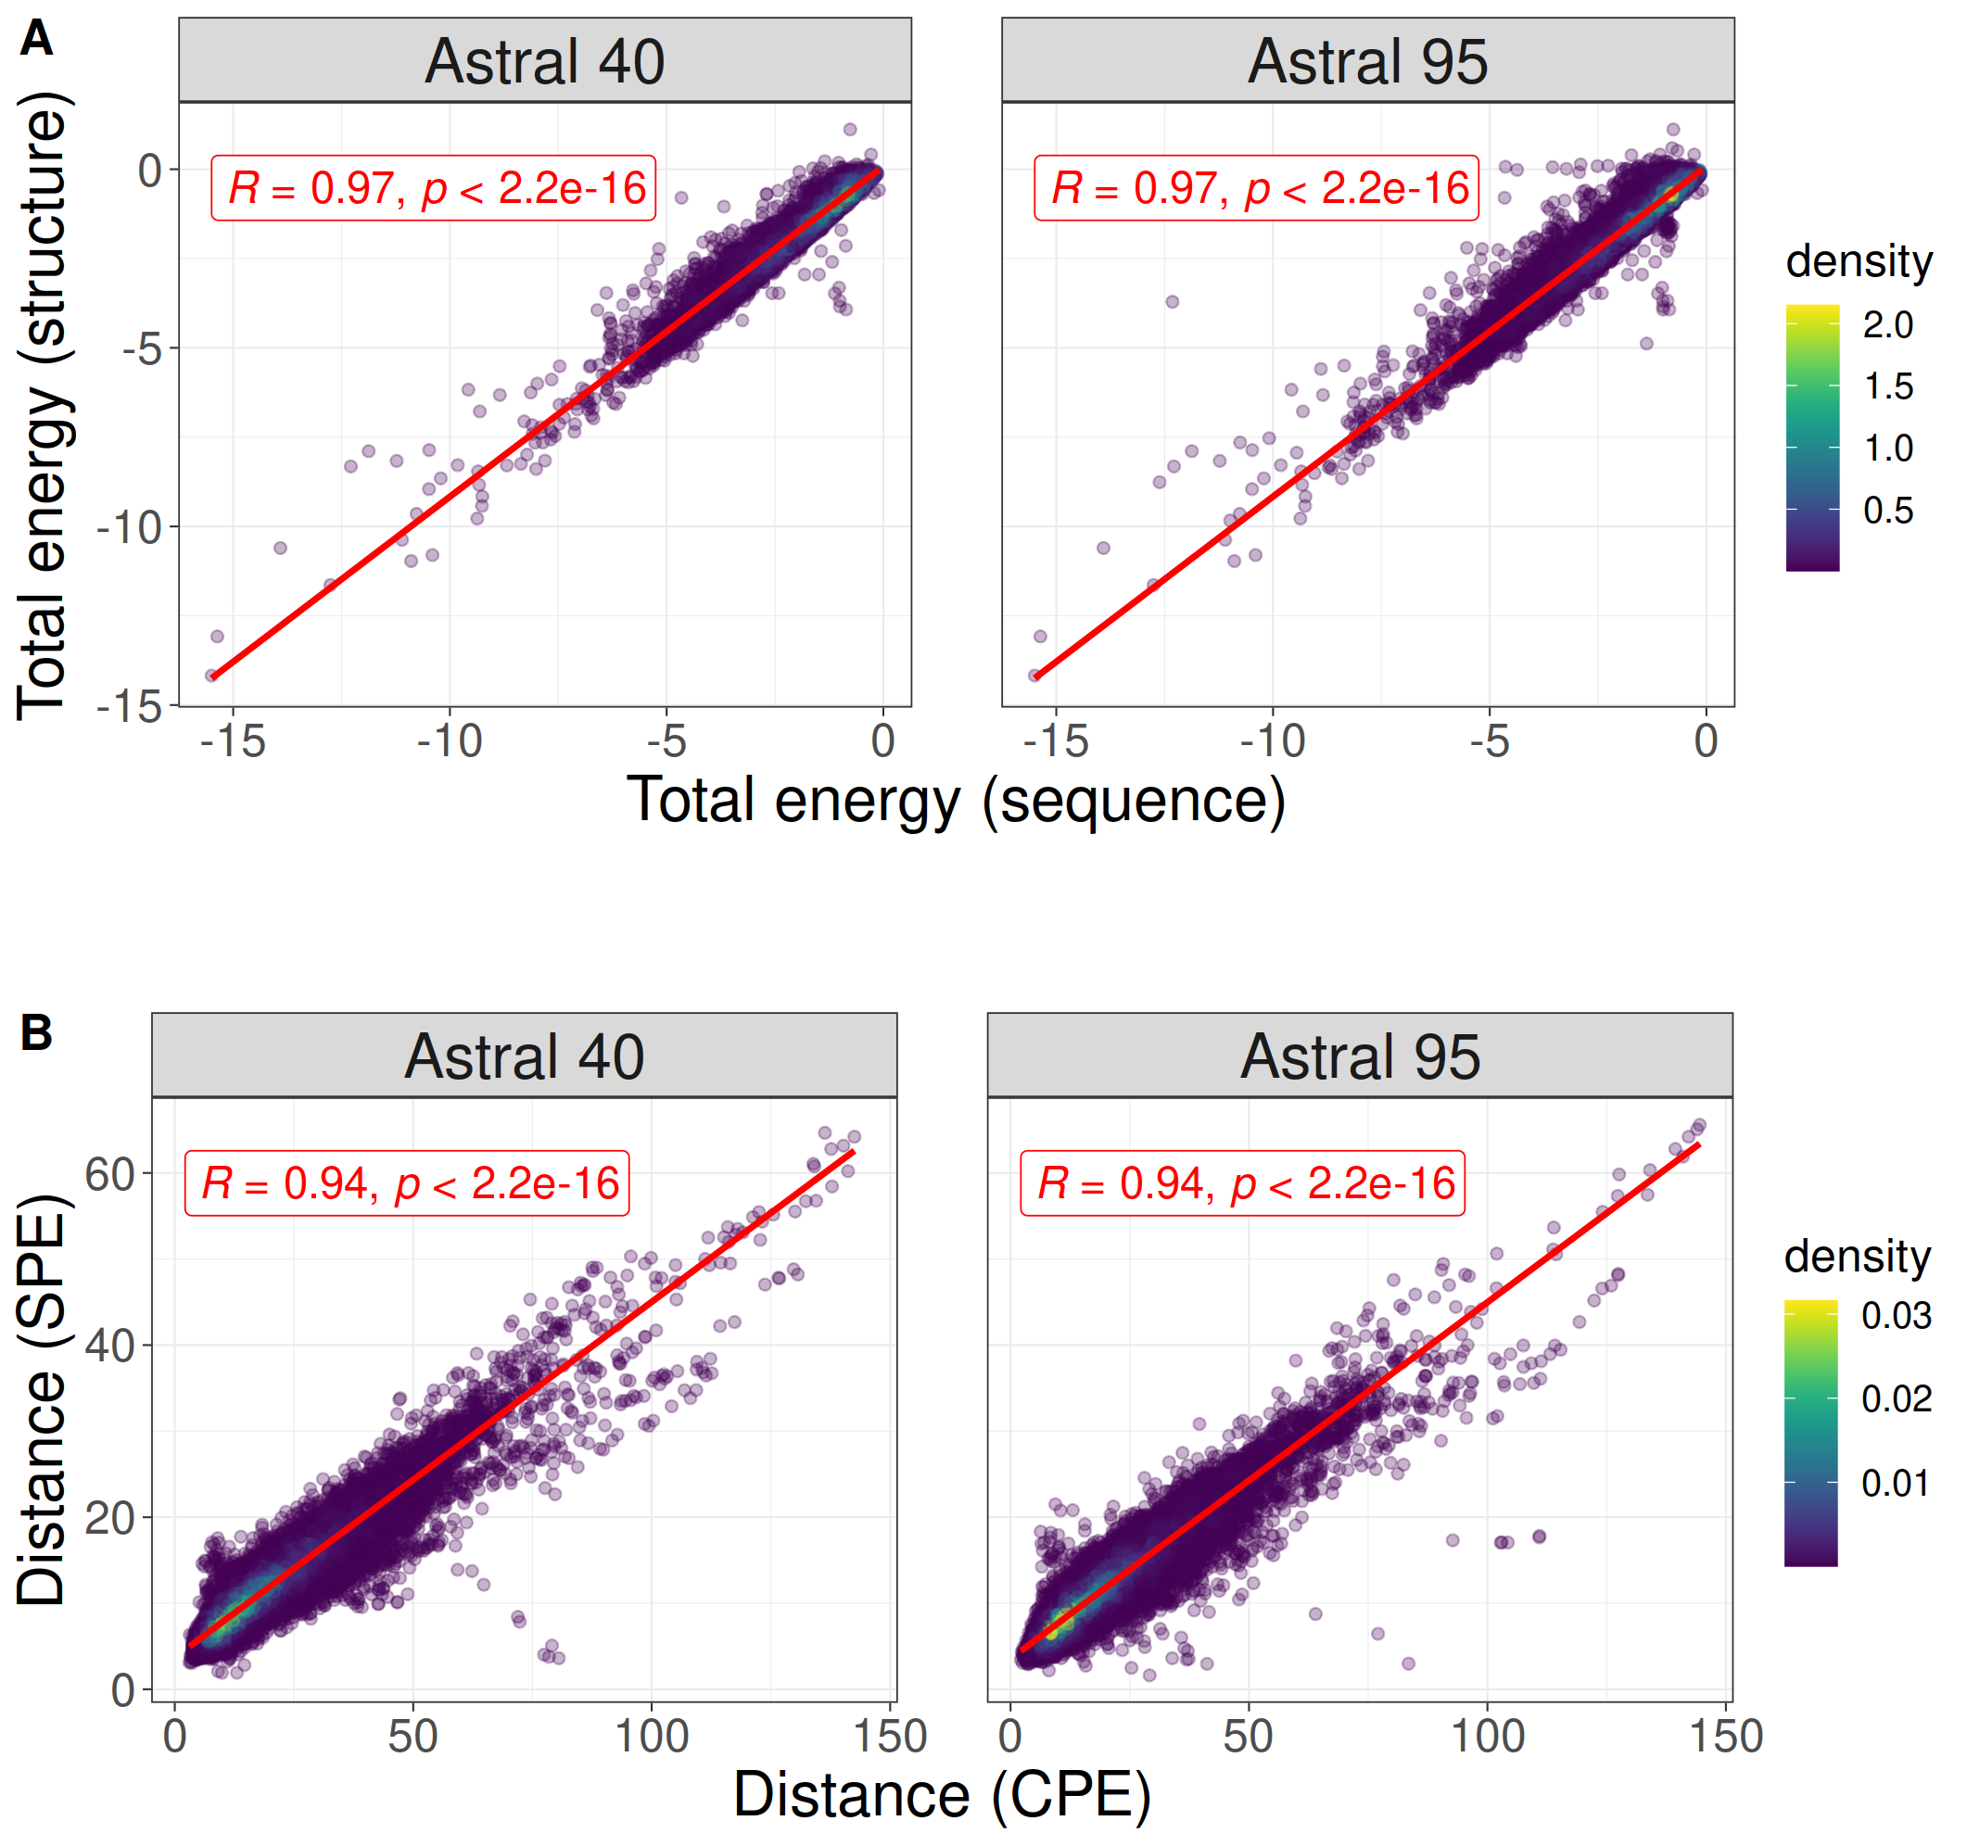
Fig1

Slide 2
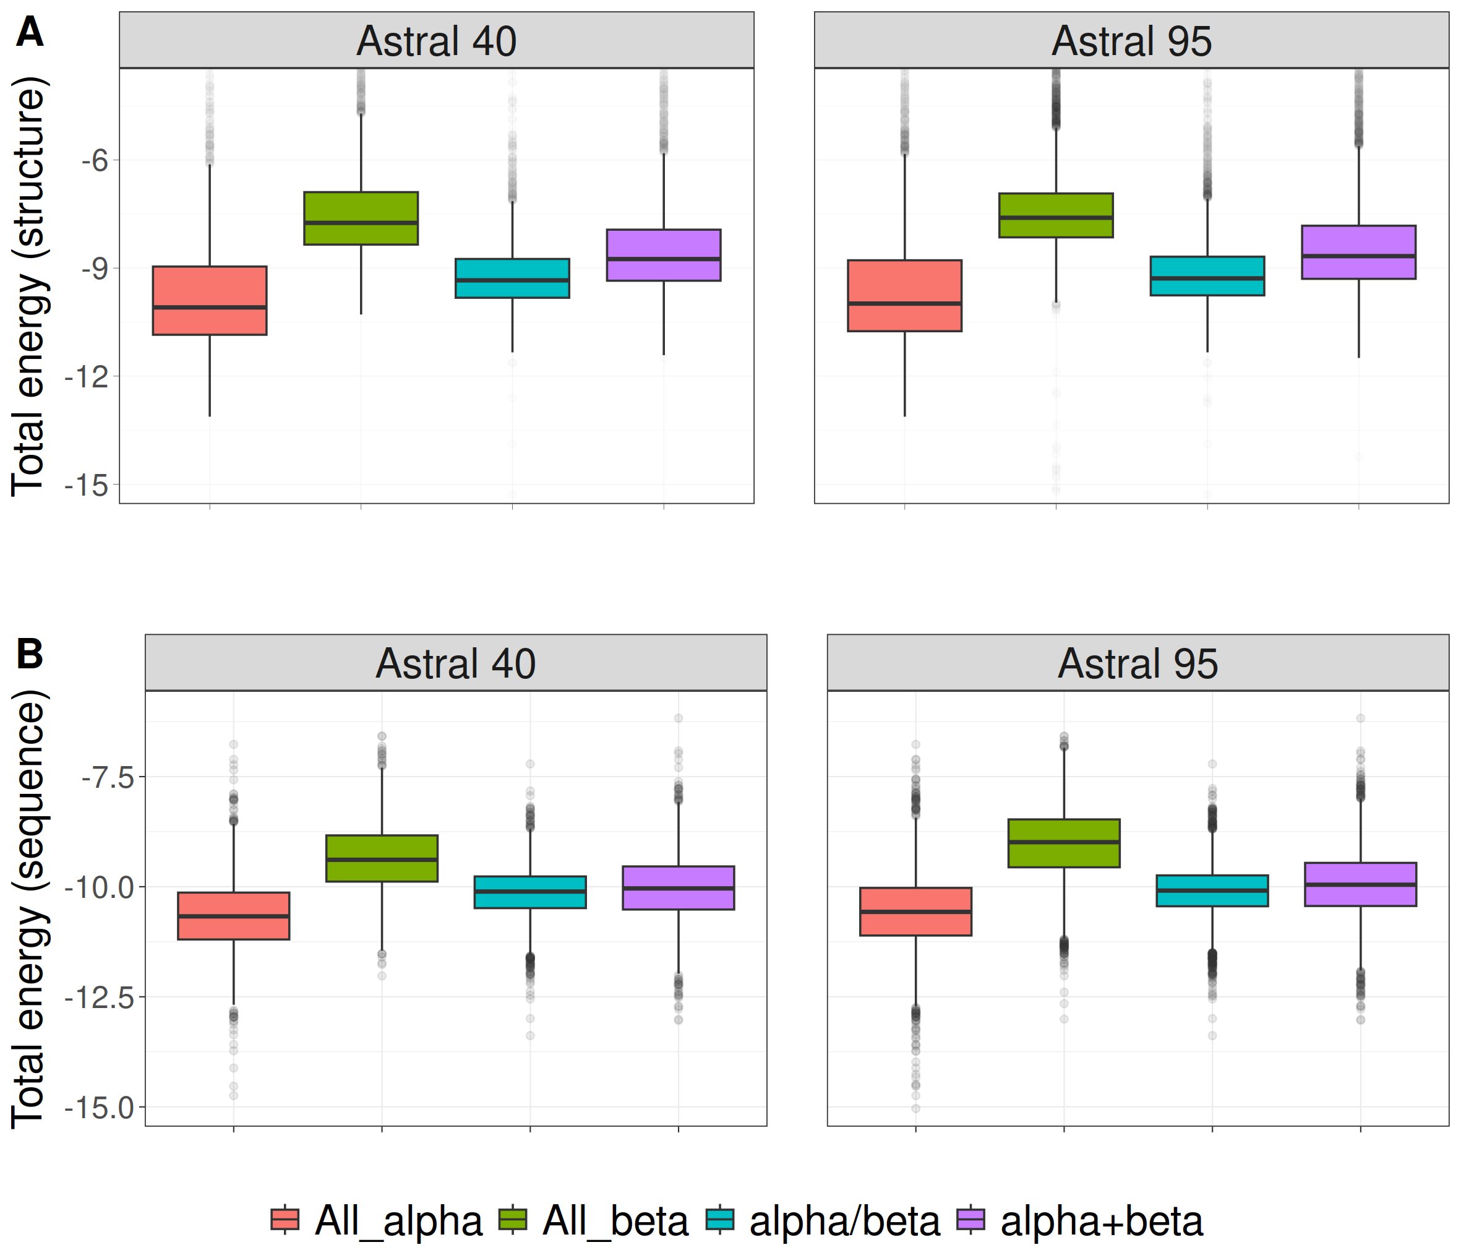
Fig2

Slide 3
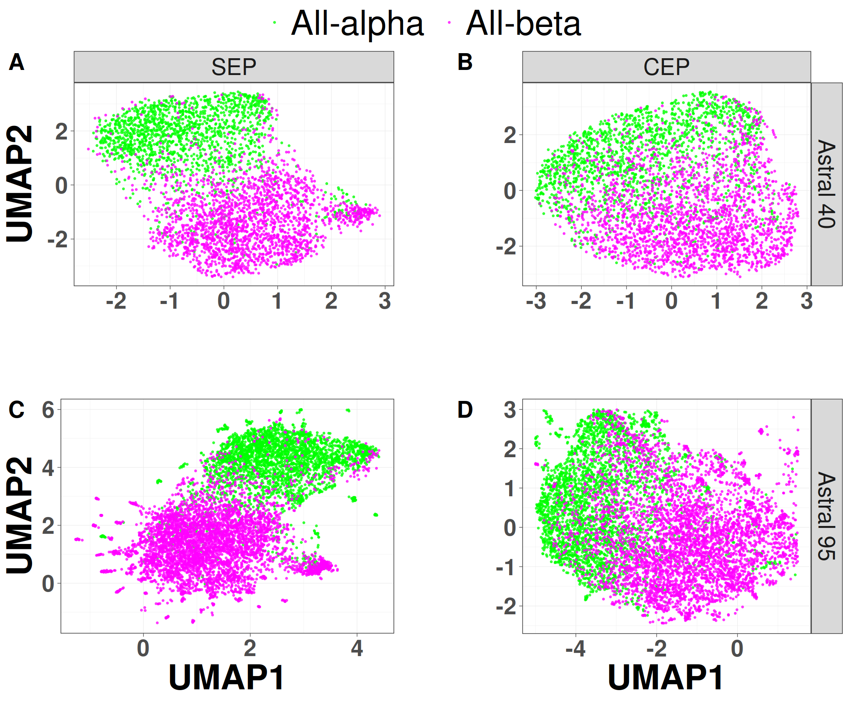
Fig3

Slide 4
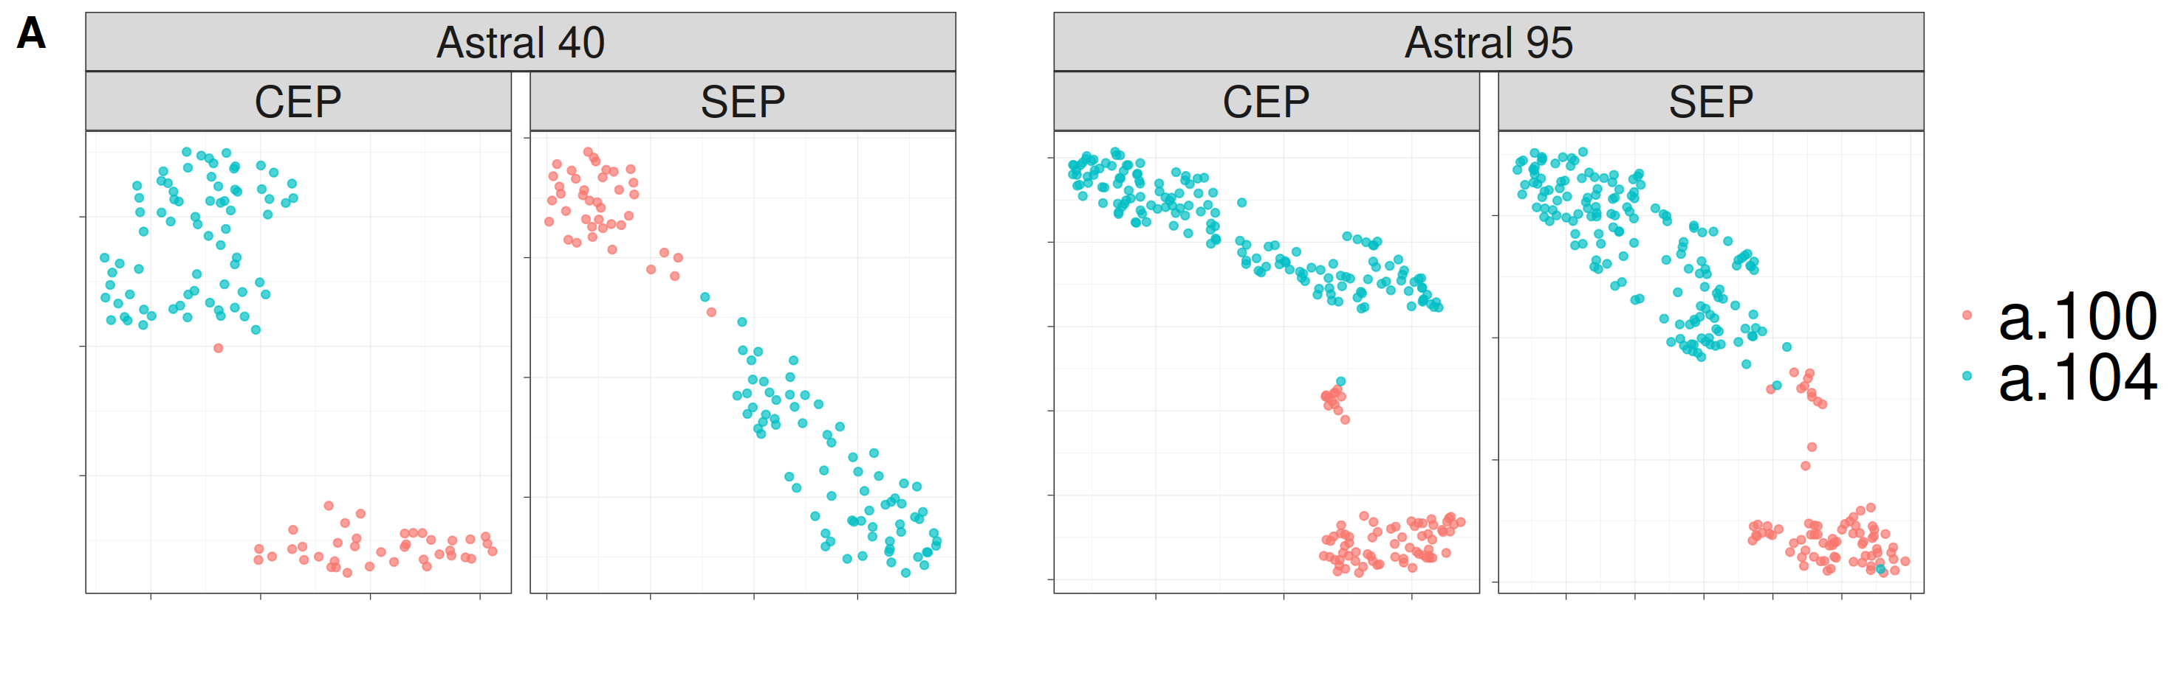
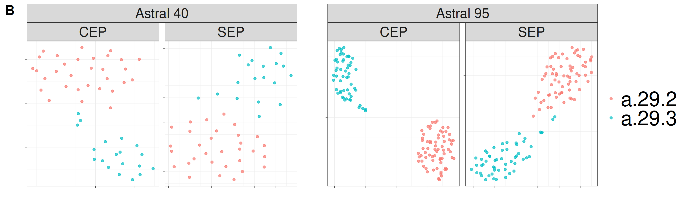
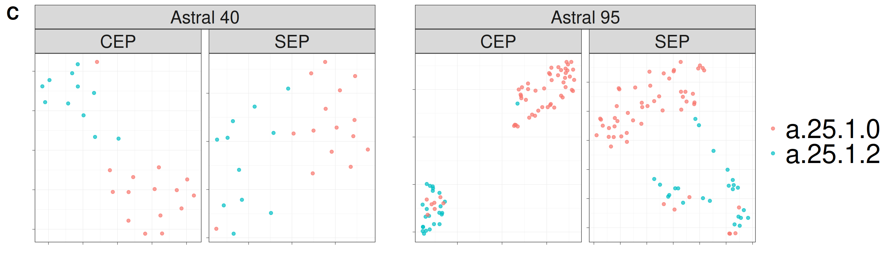
Fig4

Slide 5
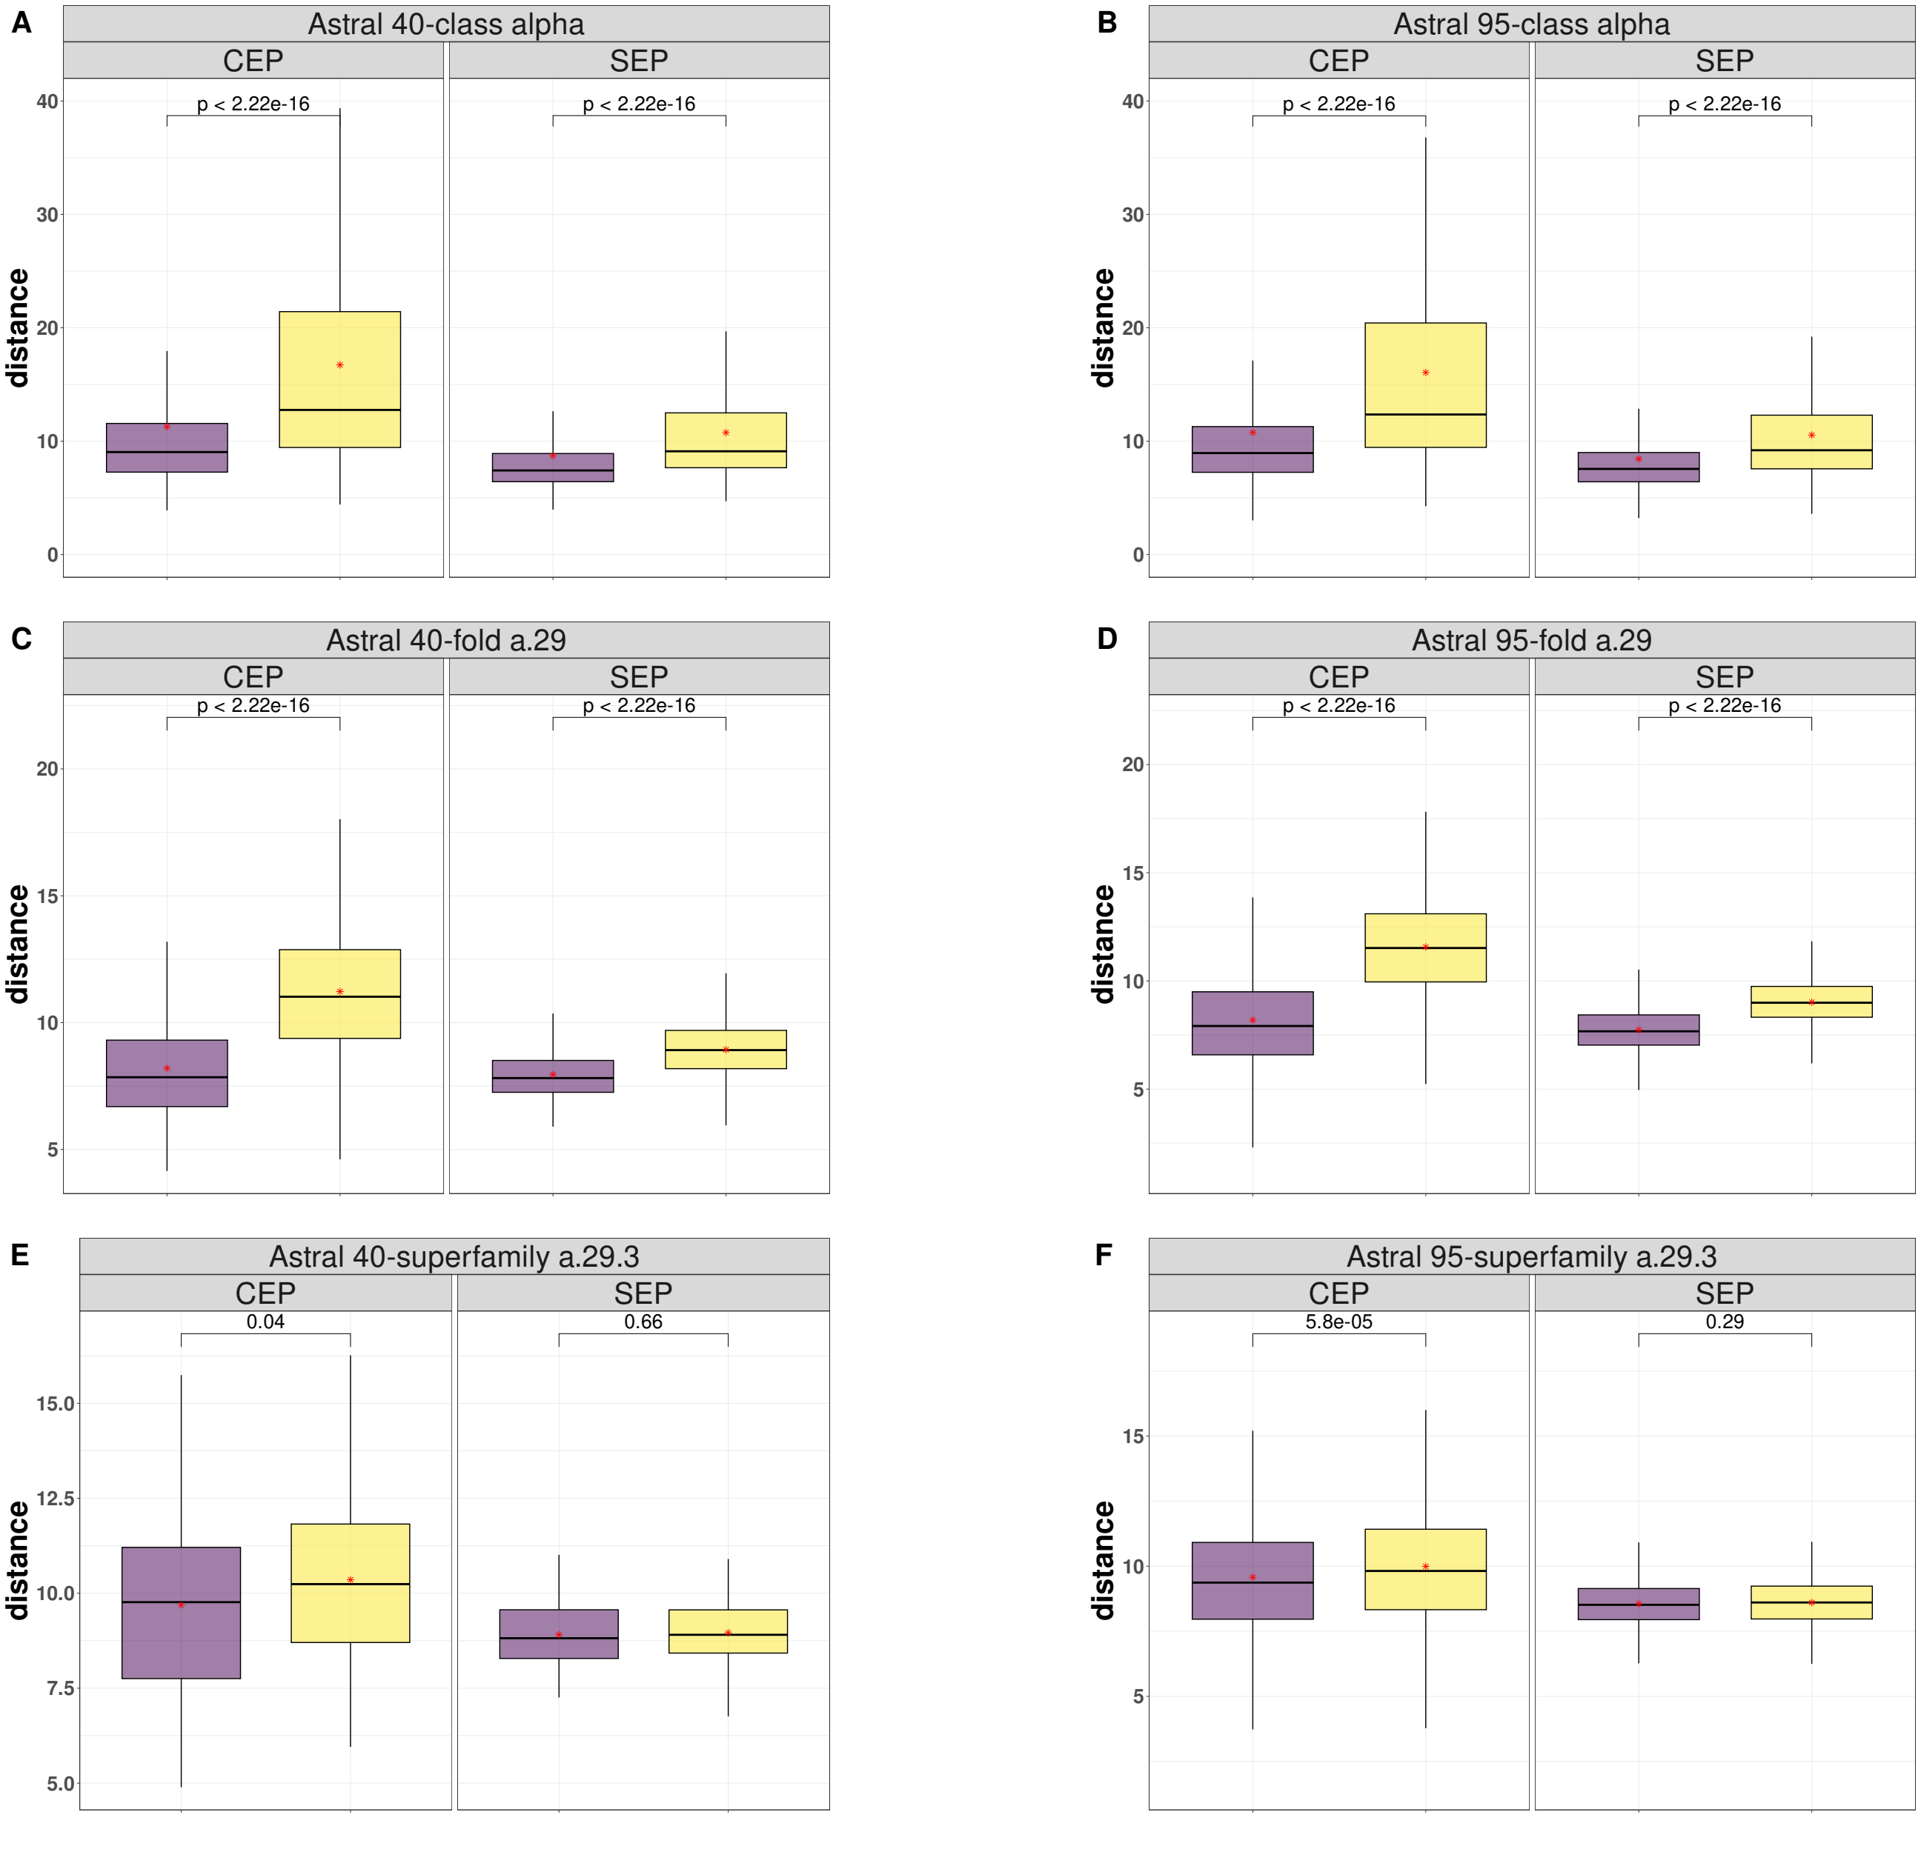
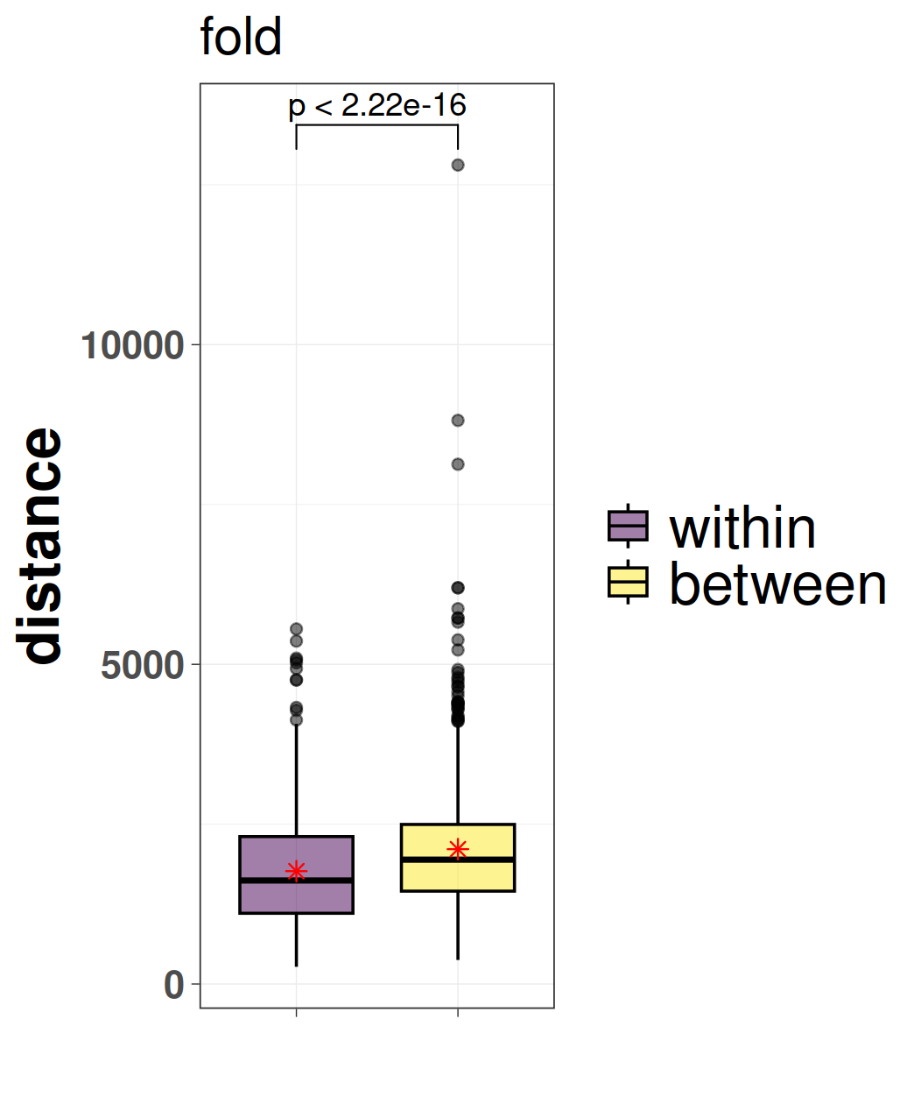
Fig5

Slide 6
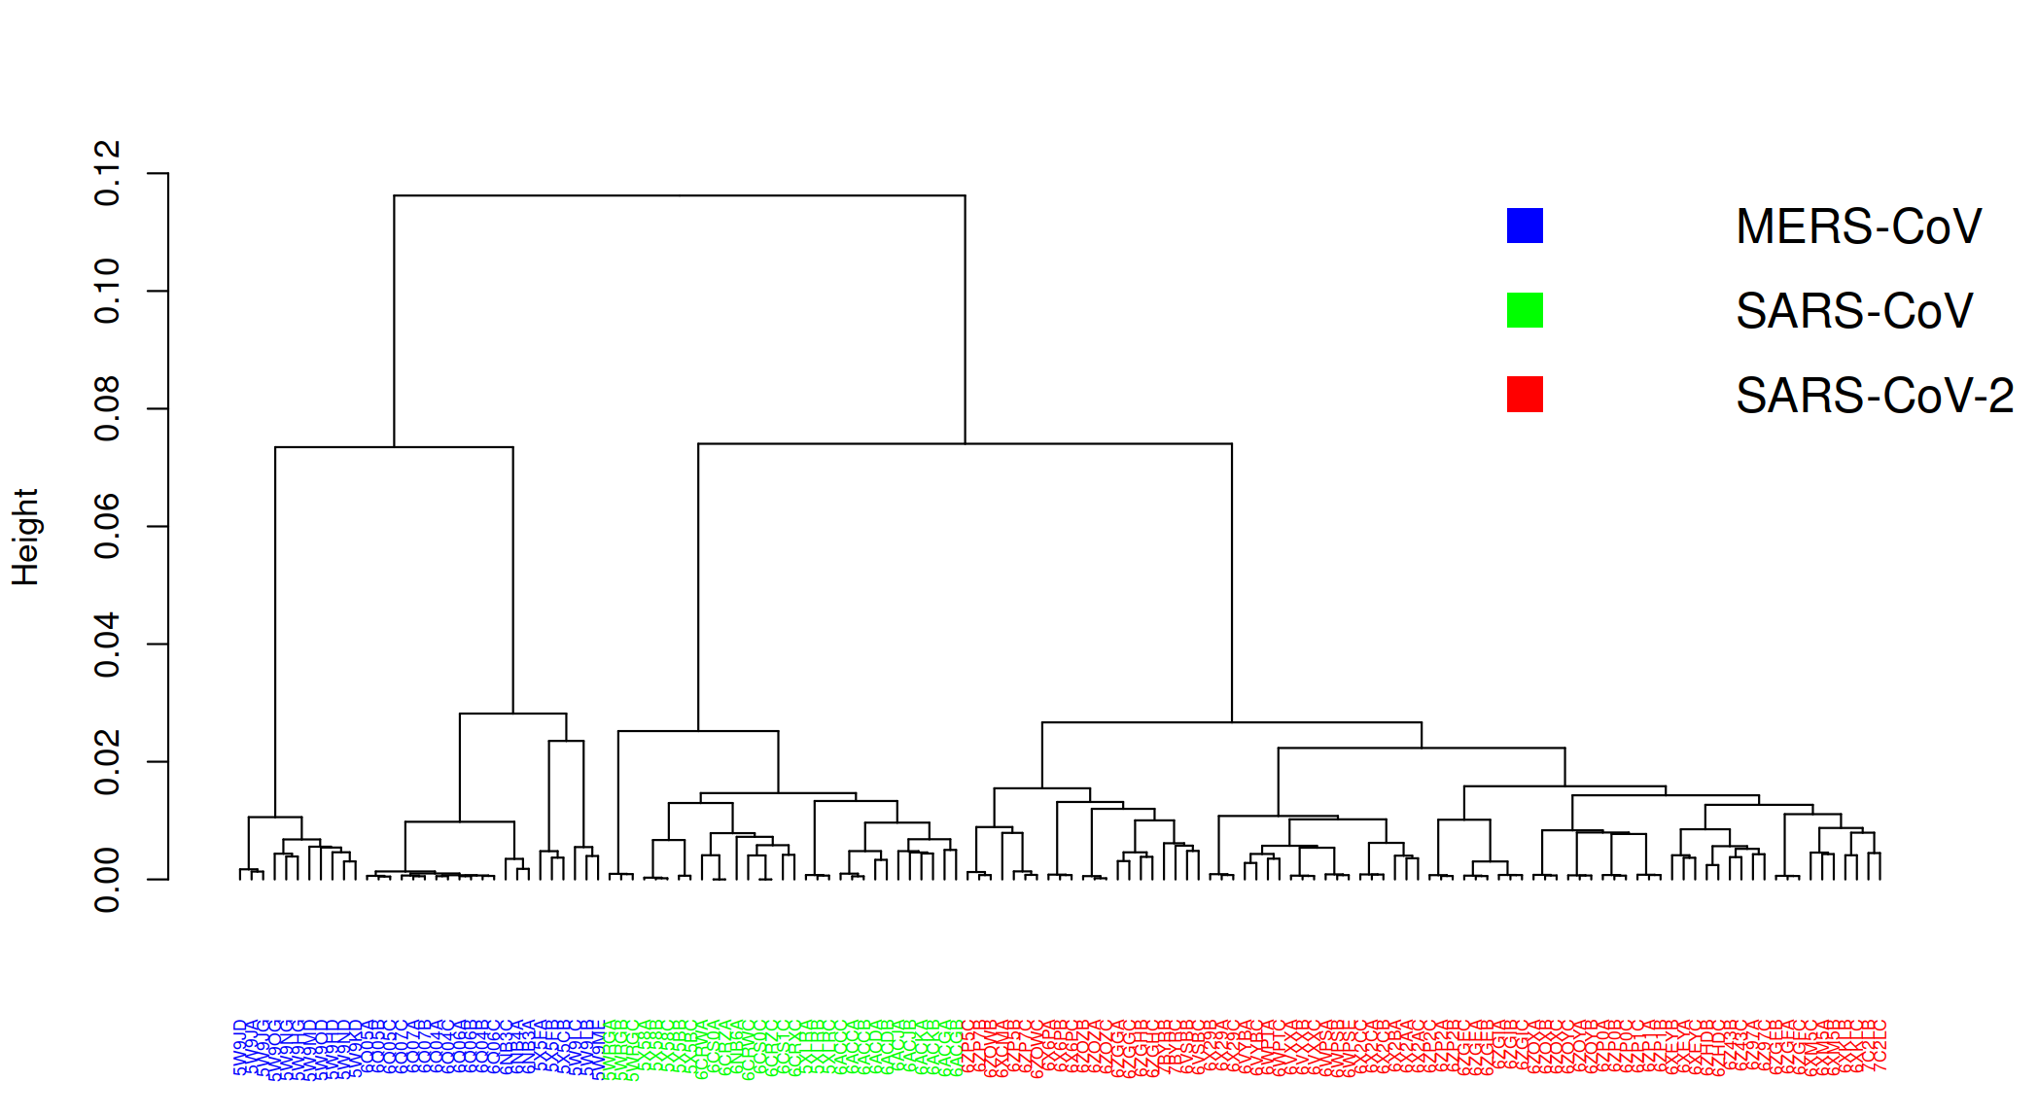
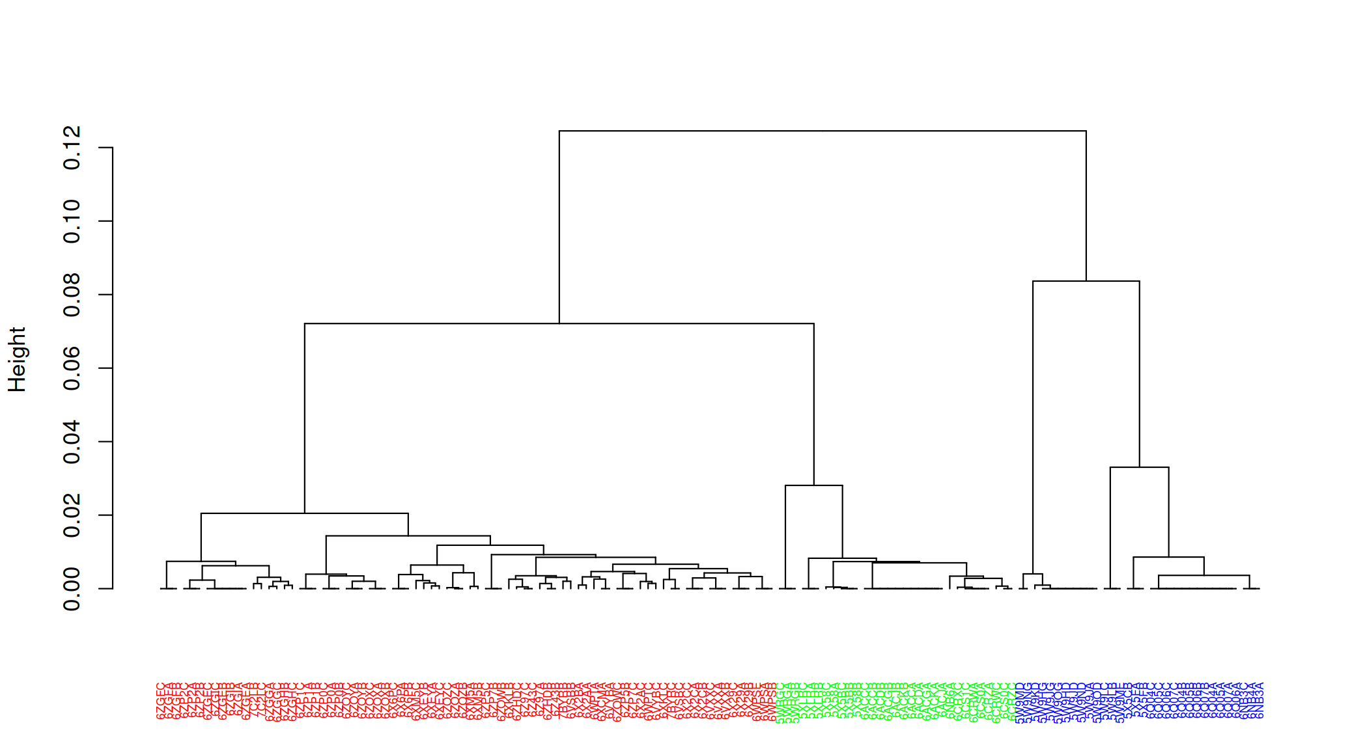
Fig6
A) SEP
B) CEP

Slide 7
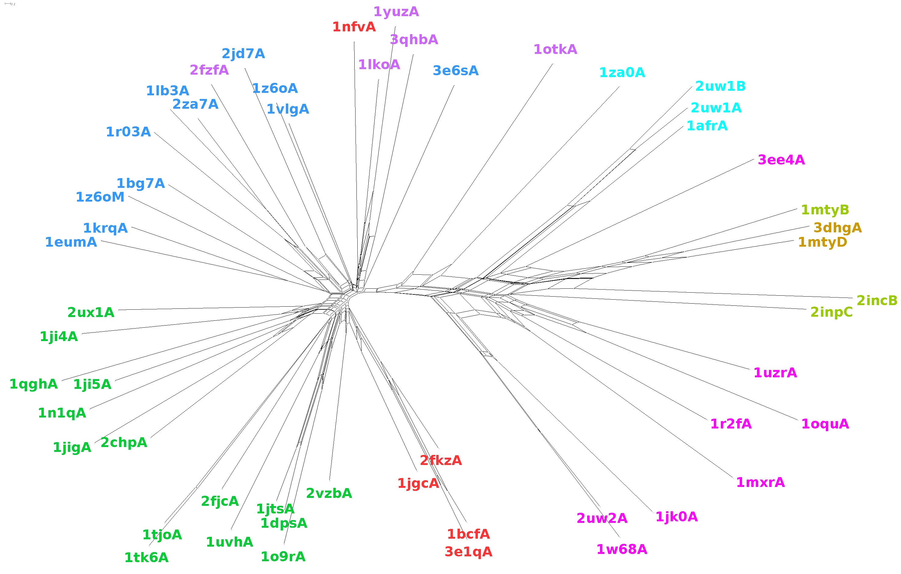
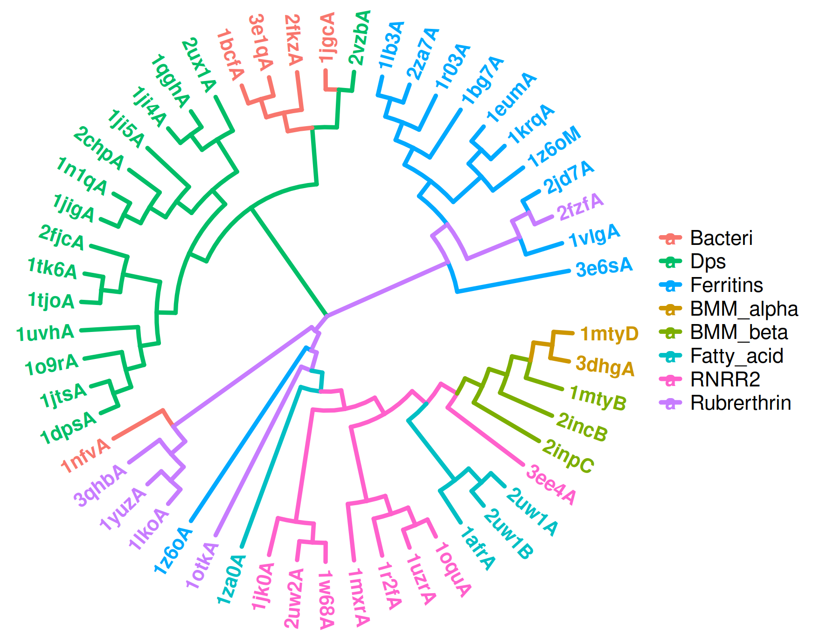
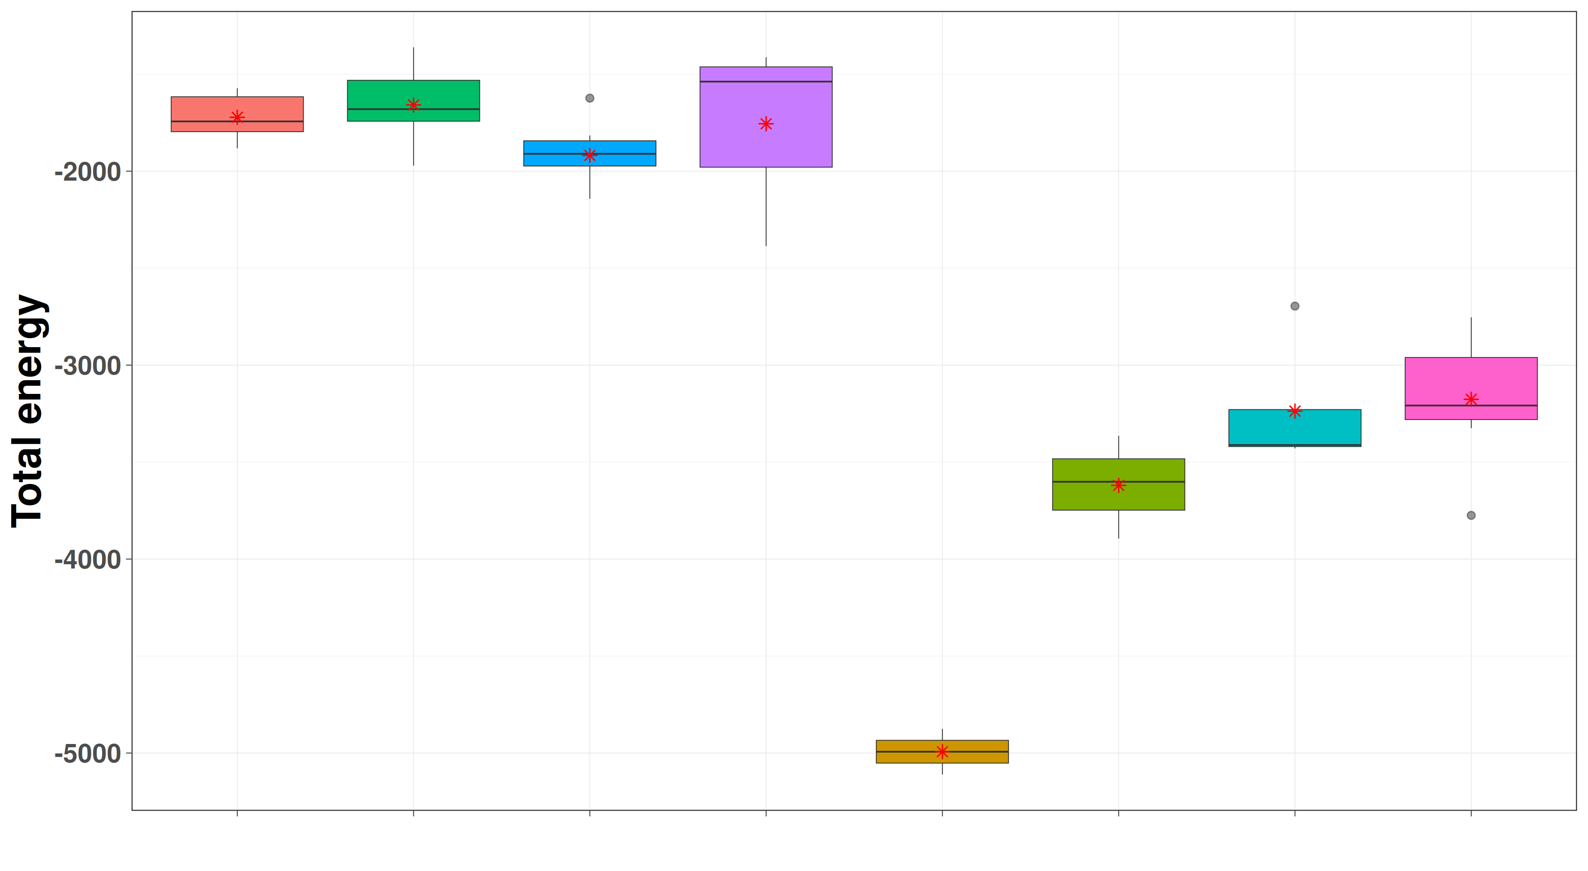
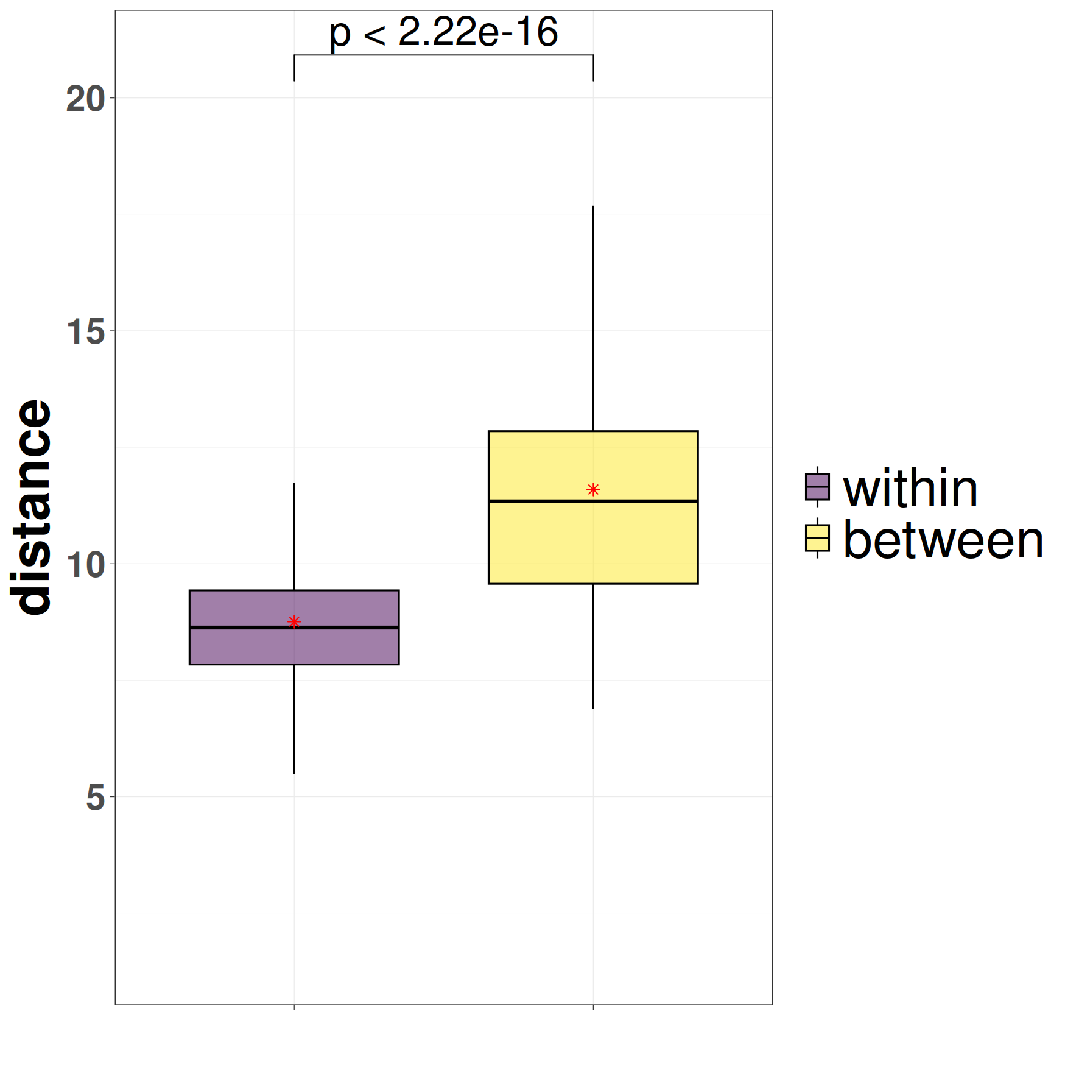
Fig9
A)
B)
a.25.1.1
a.25.1.2
C)
D)
a.25.1.1
a.25.1.2

Slide 8
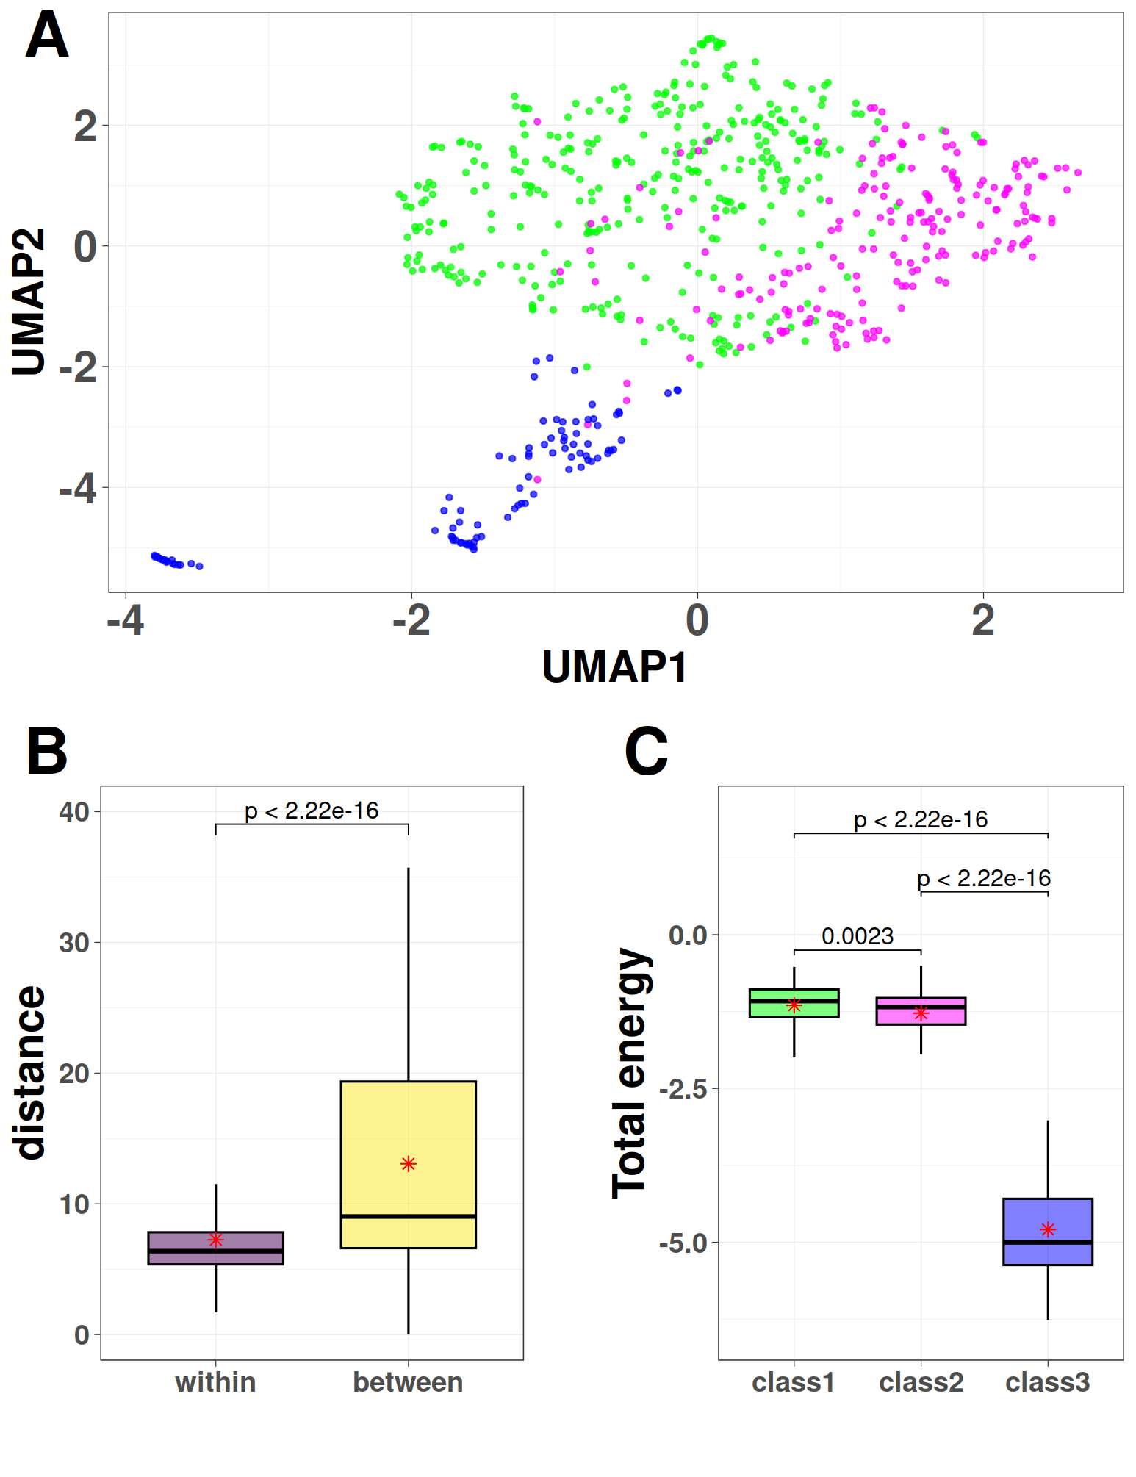
Fig8
Bacteriocin

Slide 9
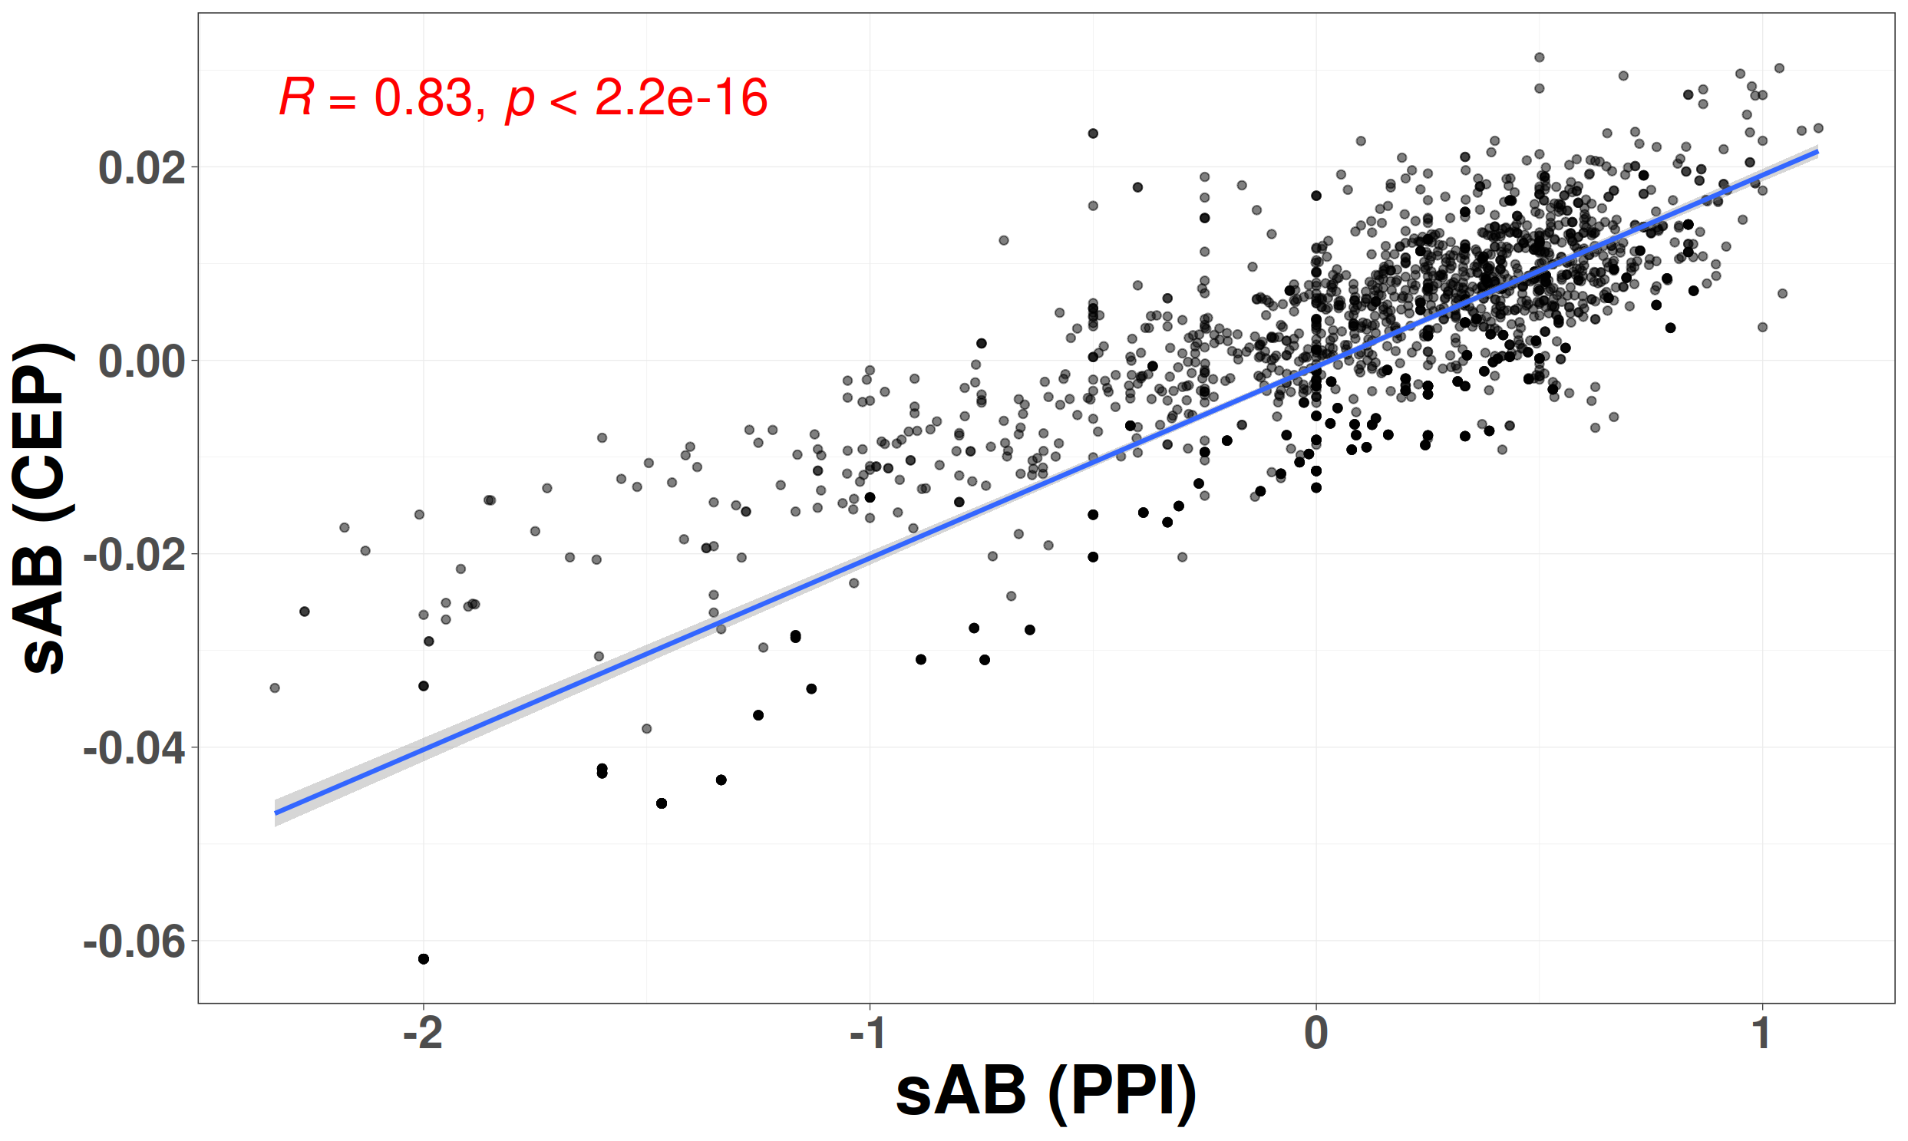
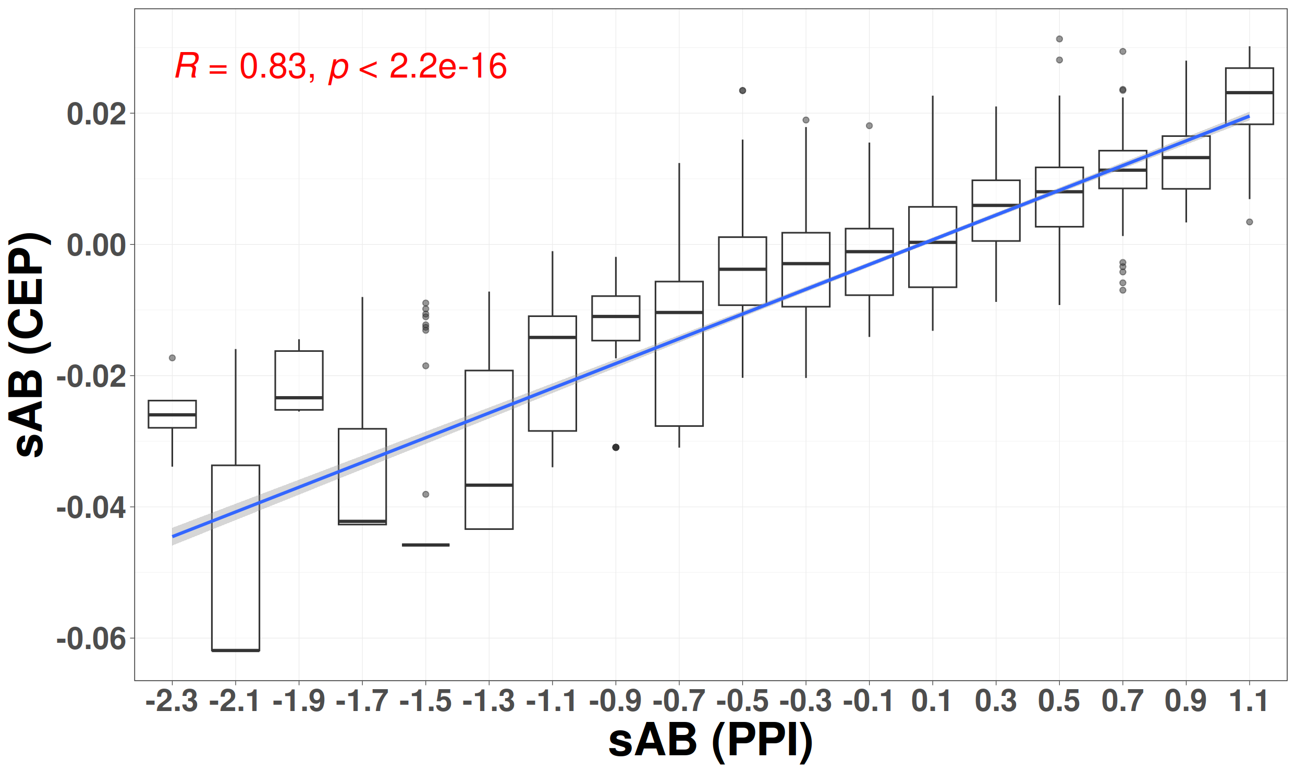
Fig9

Slide 10
Table1
 | GR-Align | RMSD | TM-Score | YH (10Rotation) | YH (2500Rotation) | CEP
Accuracy Time | 62.3% 2 min | 59.2% 1 h | 61.5% 9h 20 min | 70.8% 10 min | 81.5% 4h 10 min | 97% 3 min

Slide 11
Table2
 | Accuracy | F1: a.4.5 | F1: b.1.1 | F1: b.55.1 | F1: d.15.1 | F1: d.17.4
CEP 1NN | 0.98 | 0.98 | 0.99 | 0.96 | 0.99 | 0.99
CEP RF_10Fold_CV | 0.99 | 0.97 | 0.99 | 0.97 | 0.99 | 0.99
MPSS | - | 0.87 | 0.89 | 0.90 | 0.95 | 0.99

